Slide 1

AllFitHub

Slide 2
Health for Everyone, Everywhere…
Made by team ComiCode
AllFitHub
Get started!

Slide 3
TEAM MEMBERS
ARJUN NARANG- Worked on ORM and database.
NAVNEET SHARMA- Worked on frontend, backend and API integration.
SAMNIT SAMNIT- Worked on the frontend and UI/UX design.
GURTAJ SINGH- Worked on the frontend and API integration.
NAMJOT SINGH- Worked on the UI/UX design.

Slide 4
AGENDA
What is AllFitHub(AFH)?
Why did we make AllFitHub?
Project Breakdown
OUR FUTURE PLANS FOR AFH
Take me there!
Take me there!
Take me there!
Take me there!

Slide 5


AllFitHub
AllFitHuB is your all-in-one fitness companion, offering personalized meal planning, and an intelligent AI health assistant. Designed to cater to diverse needs, AllFitHub ensures a supportive and accessible experience for everyone on their health journey.
What are its features?

Slide 6





Provides AI-Powered Health Assistance: Get personalized health tips with its chatbot called “Zen Mentor”.
Tracks Fitness: Monitor workouts and track progress (steps, calories).
Plans Meals: Create custom plans and track nutrition.
User friendly UI: Easy to use for everyone with accessibility options.
Uses Modern Programming techniques: React.js, Node.js (Express.js), Prisma ORM, PostgreSQL.

Slide 7
What is AllFitHub(AFH)?
Why did we make AllFitHub?
Project Breakdown
OUR FUTURE PLANS FOR AFH
Take me there!
Take me there!
Take me there!
Take me there!

Slide 8
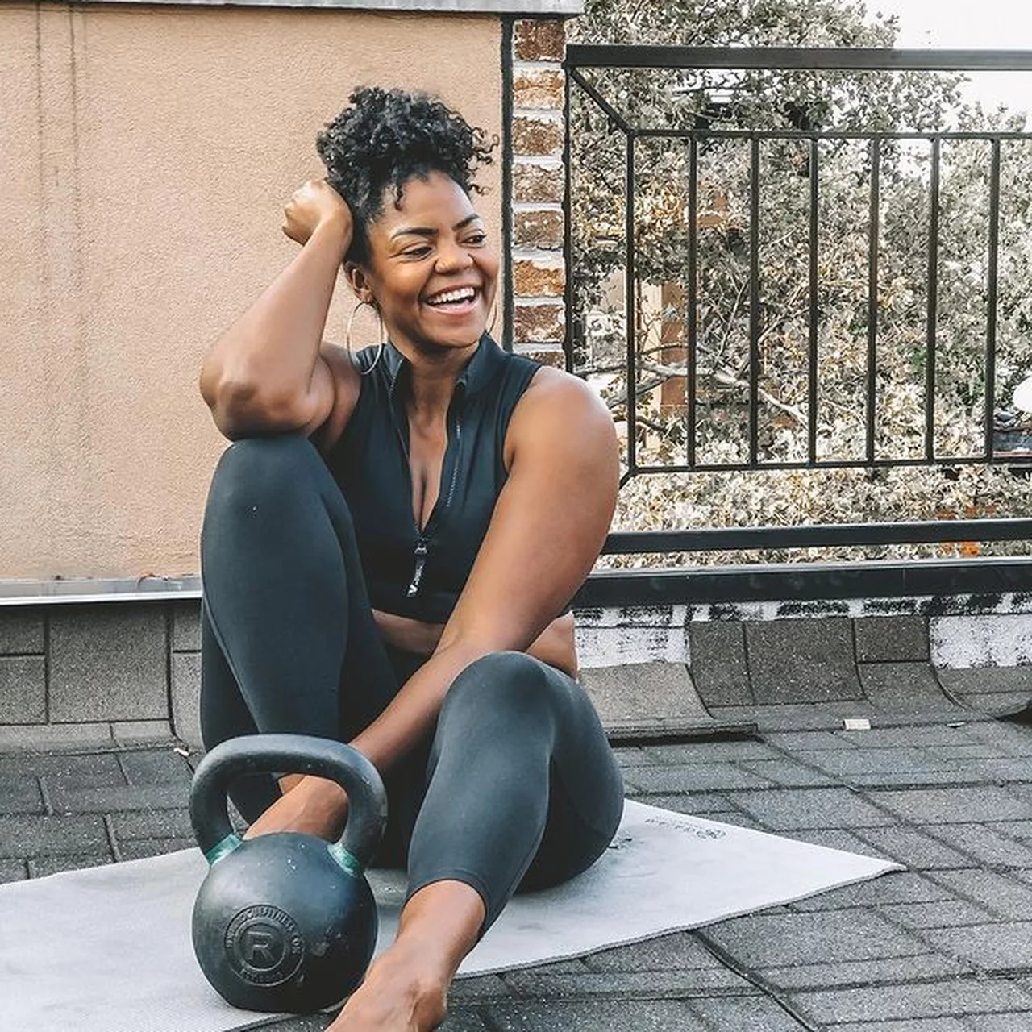
Why did we make AllFitHub?

Slide 9
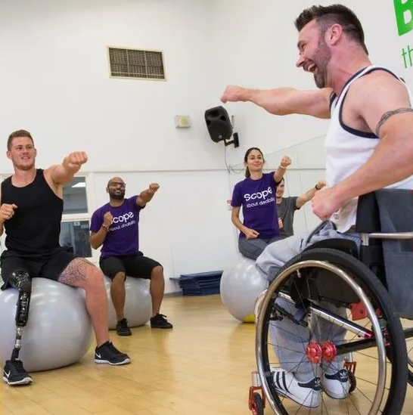
To foster a community where everyone can thrive in their health journey. Recognizing diverse needs and backgrounds, we developed a platform that unites people through a shared commitment to wellness. We believe everyone, regardless of their abilities, deserves the opportunity to pursue good health. It's more than just an app; it's a supportive space for everyone to find the tools and motivation to lead healthier lives.

Slide 10
What is AllFitHub(AFH)?
Why did we make AllFitHub?
Project Breakdown
OUR FUTURE PLANS FOR AFH
Take me there!
Take me there!
Take me there!
Take me there!

Slide 11

PROJECT BREAKDOWN

Slide 12
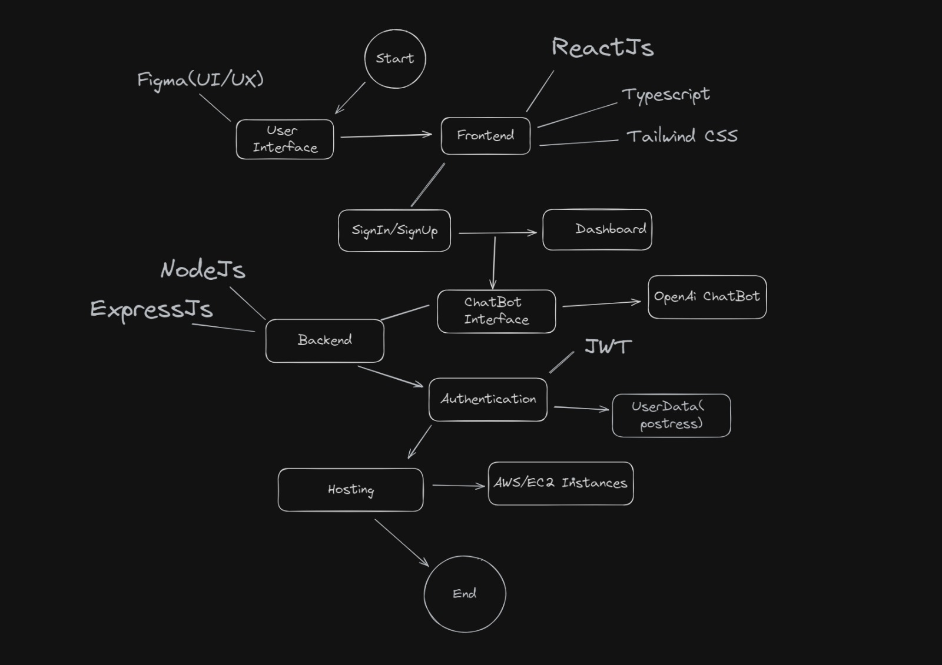
Work Breakdown Structure(WBS)

Slide 13
What is AllFitHub(AFH)?
Why did we make AllFitHub?
Project Breakdown
OUR FUTURE PLANS FOR AFH
Take me there!
Take me there!
Take me there!
Take me there!

Slide 14

Our Future plans for AFH
We aim to

Slide 15
Expand AI capabilities for more personalized health advice.
Add fitness tracking with real-time data integration from wearables.
Refine meal planning algorithms for better nutrition tracking and recipe recommendations.
Optimize user interface and platform compatibility for seamless accessibility.
Innovate continuously to stay at the forefront of health and fitness technology.

Slide 16
Conclusion
In conclusion, AllFitHub is more than just a web application; it empowers users on their health journey.
It utilizes AI for personalized health advice, advanced fitness tracking, and intuitive meal planning
Simplifies maintaining a healthy lifestyle with real-time data and continually enhanced features
AllFitHub strives to be not just a companion but a trusted guide, aiding users in making informed decisions and achieving sustainable health goals confidently.

Slide 17
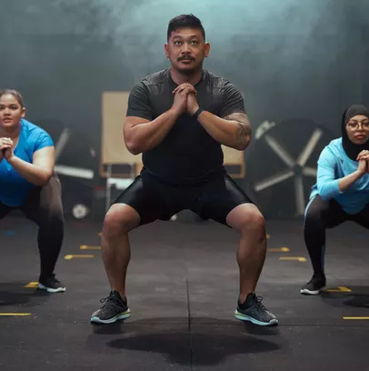
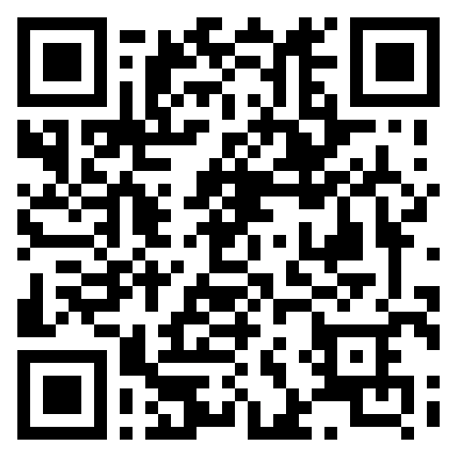
If there’s any questions, we would be happy to answer them. or You can scan the QR code below and submit your questions to us!

Slide 18
Thank you

